Slide 1
CLASS 11th
Physics
1. Trigonometric Formulae
2. Calculus (Differentiation & Integration)
3.Motion In a Straight Line
By Prashant Sir
Lecture Notes

Slide 13
T- ratios of allied angles
When angle (say) ϴ is negative then
(a) sin (- ϴ) = | - sin ϴ
(b) cos (- ϴ) = | cos ϴ
(c) tan (- ϴ) = | - tan ϴ
When ϴ is less than 90⁰ (i.e. lies in I quadrant )
(a) sin (90⁰ - ϴ) =
(b) cos (90⁰ - ϴ) =
(c) tan (90⁰ - ϴ) =
When ϴ lies between 90⁰ and 180⁰ then (i.e. lies in II quadrant )
(a) sin (90⁰ + ϴ) =
(b) cos (90⁰ + ϴ) =
(c) tan (90⁰ + ϴ) =
(a) sin (180⁰ - ϴ) =
(b) cos (180⁰ - ϴ) =
(c) tan (180⁰ - ϴ) =

Slide 14
When ϴ lies between 180⁰ and 270⁰ then (i.e. lies in III quadrant )
(a) sin (180⁰ + ϴ) =
(b) cos (180⁰+ ϴ) =
(c) tan (180⁰+ ϴ) =
(a) sin (270⁰ - ϴ) =
(b) cos (270⁰ - ϴ) =
(c) tan (270⁰ - ϴ) =
When ϴ lies between 270⁰ and 360⁰ then (i.e. lies in IV quadrant )
(a) sin (270⁰ + ϴ) =
(b) cos (270⁰ + ϴ) =
(c) tan (270⁰ + ϴ) =
(a) sin (360⁰ - ϴ) =
(b) cos (360⁰ - ϴ) =
(c) tan (360⁰ - ϴ) =

Slide 15
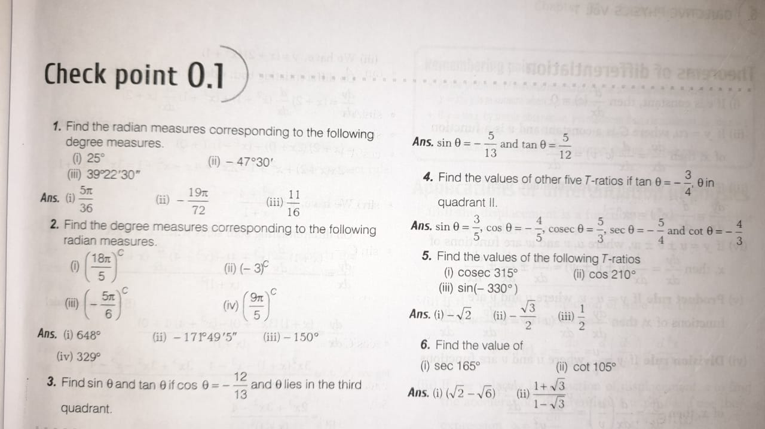

Slide 16
CLASS 11th
Physics
Calculus
Lecture
By
Mr. Prashant Pachangre

Slide 31
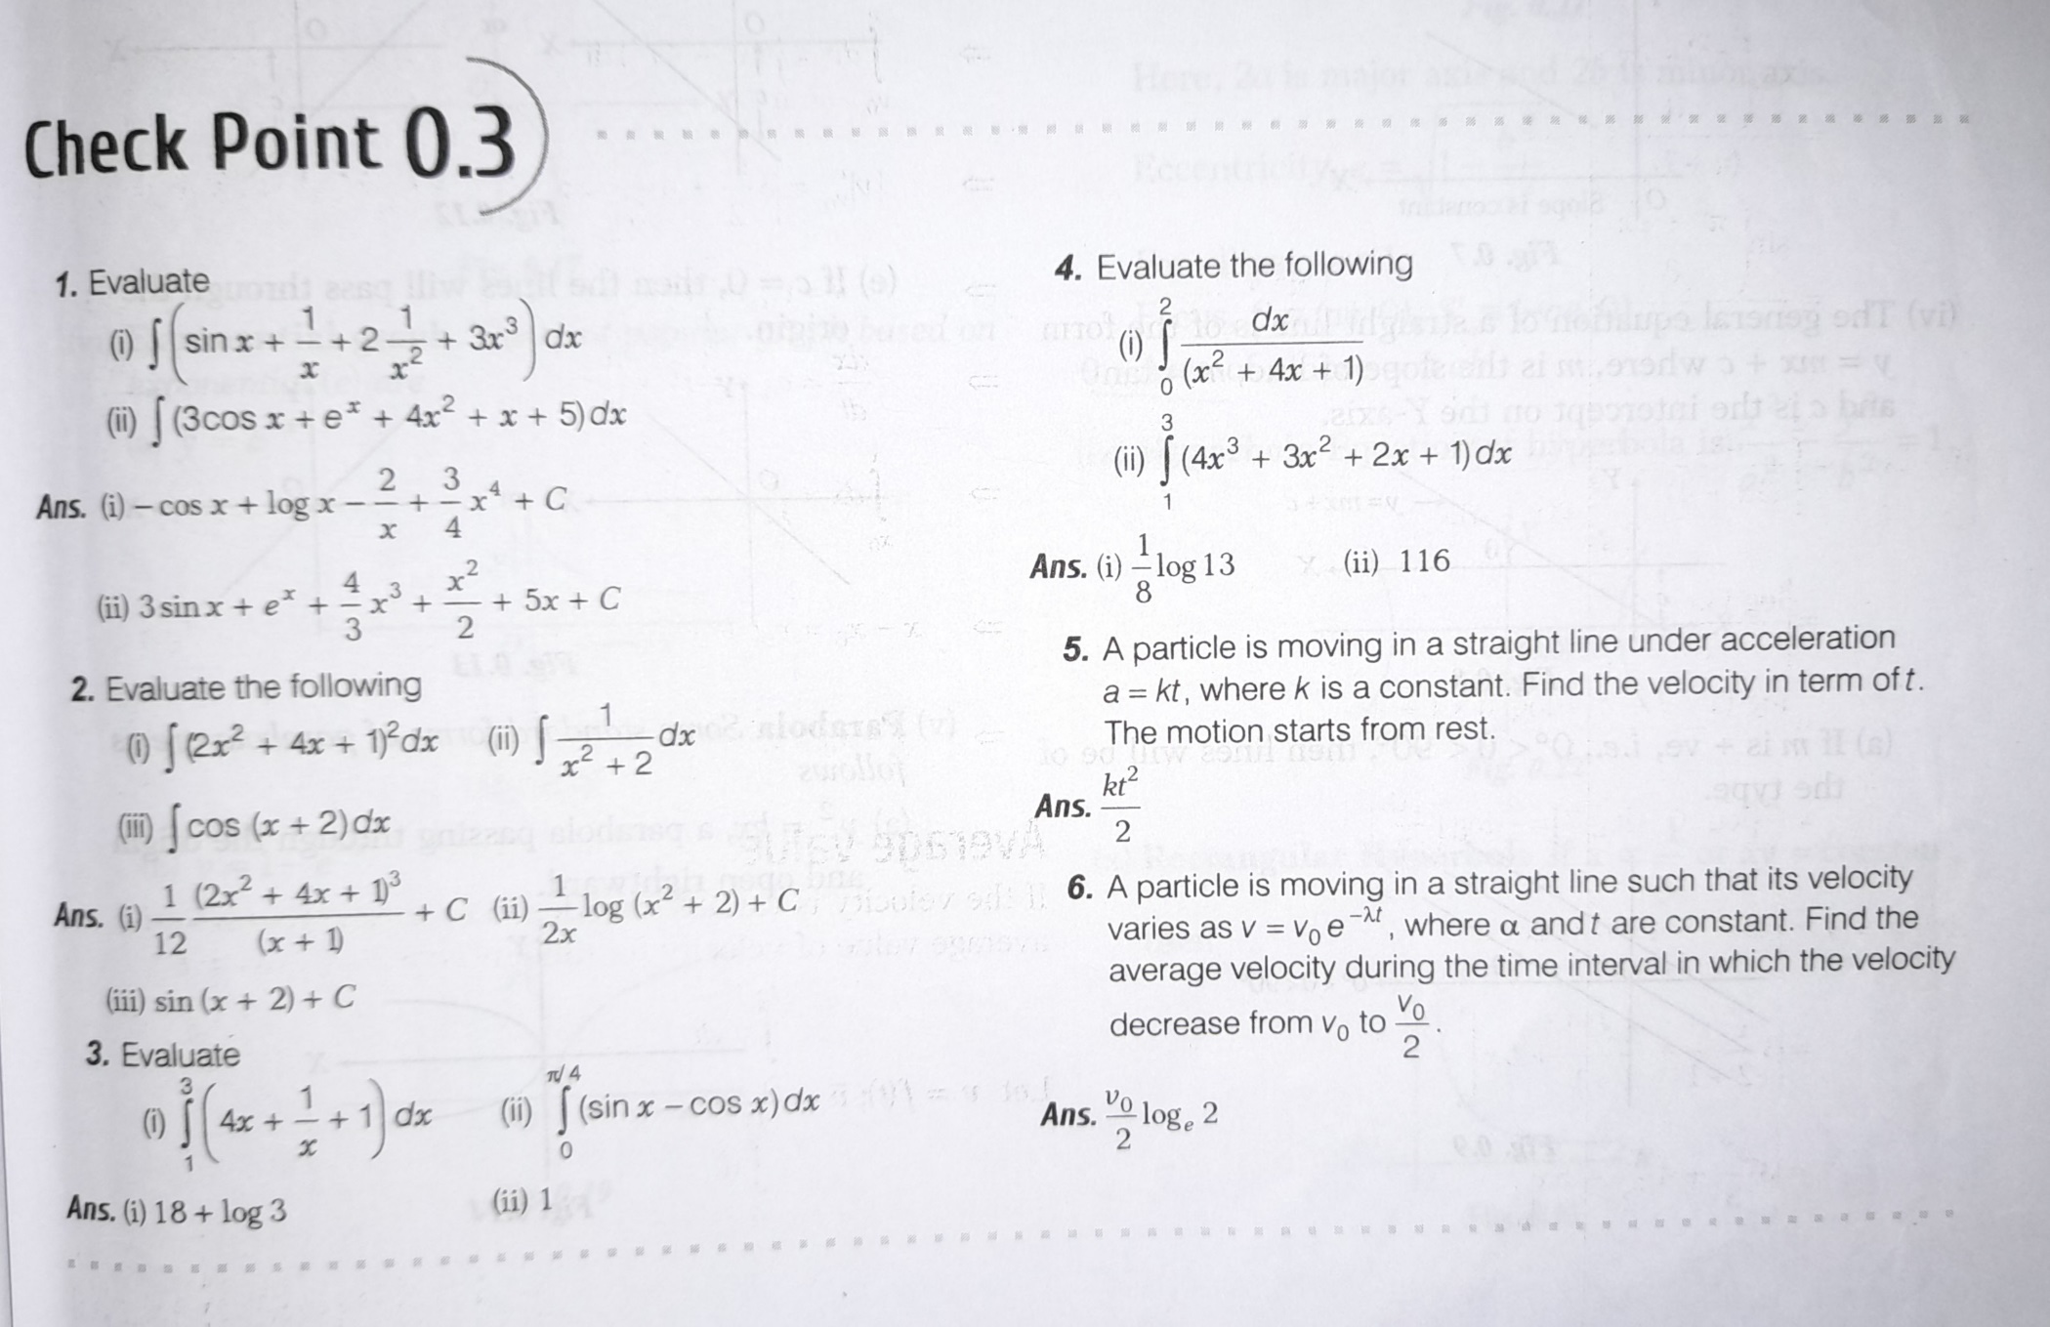

Slide 50
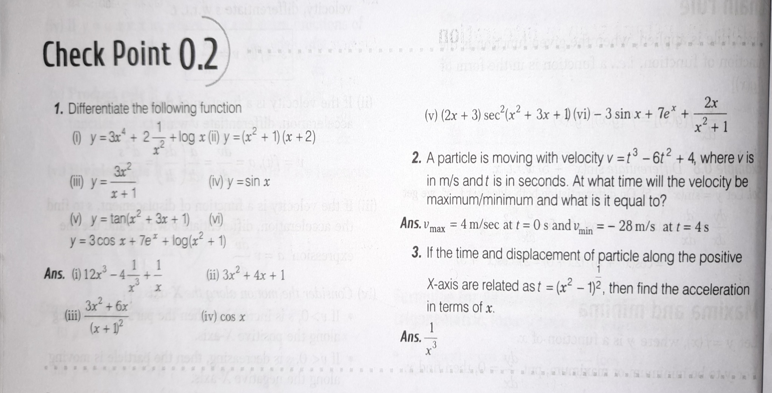

Slide 64
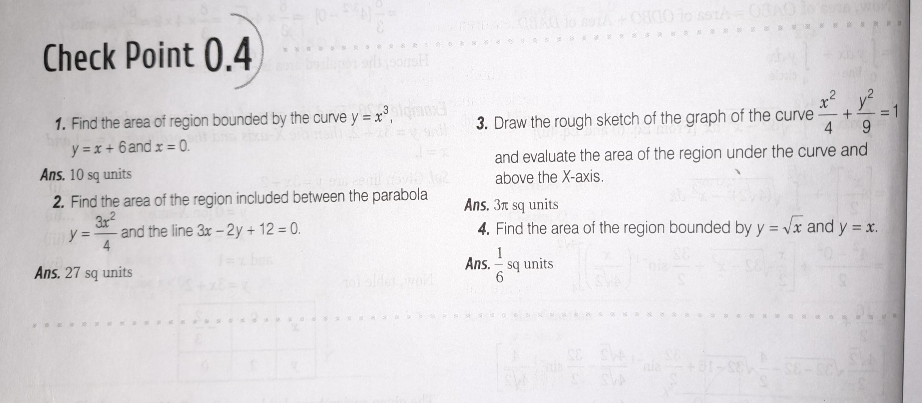

Slide 65
Calculus
1. Differentiation
2. Integration

Slide 80
Introduction
We observe that bodies are either in motion or rest. A body is said to be in motion if it changes its position w.r. to its surroundings with the passage of time.
Rest: an object is said to be at rest if it does not change its position w.r. to its surroundings with the passage of time.
e.g. a book placed on the table remain on the table
Motion: An object is said to be in motion if it changes its position w.r.to its surroundings with the passage of time.
e.g. A speeding car is in motion because car changes its position w.r. to its surroundings.
“Rest and Motion are relative terms”
Point Object: An object is considered as point object if its size of the object is much smaller than the distance , it moves in a reasonable duration of time.
e.g. ball on ground, here ball is considered as point object because size of ball is much smaller than ground.

Slide 92
Average velocity = $\frac{Initial velocity +Final velocity}{2}$

Slide 93
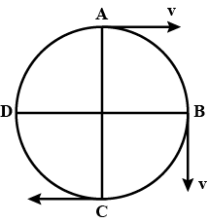
Instantaneous Velocity : -

Slide 94
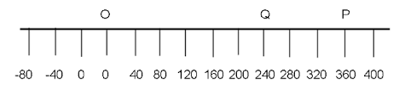
Q. A car covers is moving along a straight line, say OP in the figure . It moves from O to P in 18 second and return from P to Q in 6 second . What are the average velocity and average speed of the car in going (i) from O to P & (ii) From O to P and back to Q?

Slide 95
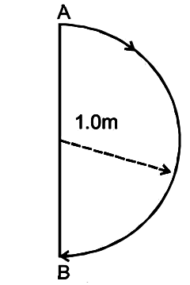
H.W. Q. In one second a particle goes from point A to point B moving in a semicircle as shown in figure. Find the magnitude of average velocity.
Ans: Average velocity = 2 m/s

Slide 96
Acceleration :
Uniform Acceleration:

Slide 97
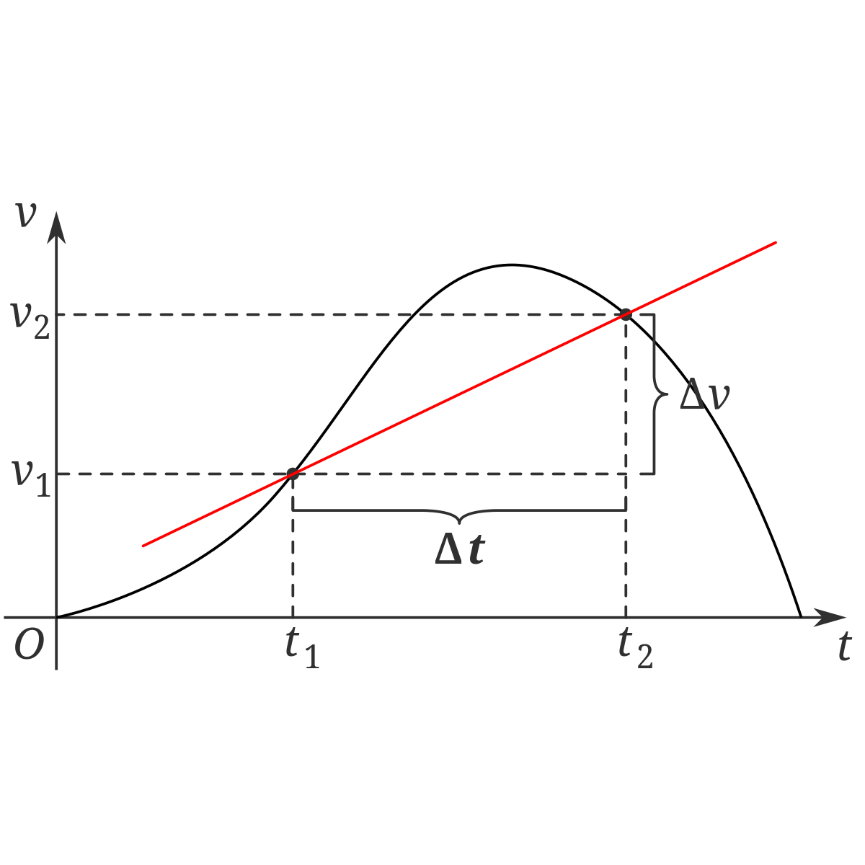
Variable Acceleration:
Average Acceleration:

Slide 98
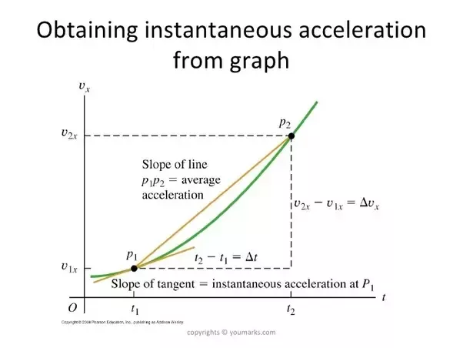
Instantaneous Acceleration:

Slide 99
Q. The velocity of a particle is given by v = 2t² -3t + 10 m/s. Find the instantaneous acceleration at t = 5 sec.

Slide 100
Q. A particle is moving with a velocity of v = (3 +6t +9t²) cm/s . Find out (a) the acceleration of the particle at t = 3 sec. (b) displacement at t = 5 sec to 8 sec.

Slide 101
Q. The motion of a particle along a straight line is described by the function x = (2t -3)² where x is in metre and t in second. (i) Find the position , velocity & acceleration at t = 2 sec.(ii) Find velocity of the particle at origin.
Ans : (i) s = 1 m, v = 4 m/s, a = 8 m/s² (ii) v = 0

Slide 102
Q. The velocity of a particle is given by v = 2t² -3t + 10 m/s. Find the instantaneous acceleration at t = 5 sec.

Slide 103
Q. A particle is moving with a velocity of v = (3 +6t +9t²) cm/s . Find out (a) the acceleration of the particle at t = 3 sec. (b) displacement at t = 5 sec to 8 sec.

Slide 104
Q. The motion of a particle along a straight line is described by the function x = (2t -3)² where x is in metre and t in second. (i) Find the position , velocity & acceleration at t = 2 sec.(ii) Find velocity of the particle at origin.
Ans : (i) s = 1 m, v = 4 m/s, a = 8 m/s² (ii) v = 0

Slide 105
Uniformly Accelerated Motion

Slide 118
Thank You !!!

